Slide 1
Surveyors Capacity Building Plan
Surveying Division
Ministry of Lands & Natural Resources
Tonga
11th august 2010

Slide 2
Background
Nearly all survey in Tonga are carryout by the Surveying Division of the Ministry of Lands & Natural Resources
All cadastral and geodetic survey is done by the ministry and most of the engineering and topographic survey.
Hydrographic survey is under HM Armed Forces
About 4 private companies have permit to conduct survey in Tonga
Under Tonga’s Land Act, The Minister of Lands directs all survey in Tonga
Draft of Tonga’s first Survey Act is schedule to complete this year
Nearly all senior surveyors have retired or approaching retirement age within 2-3 years.
Capacity Building plans were approved by Hon Minister of Lands in 2017.

Slide 3
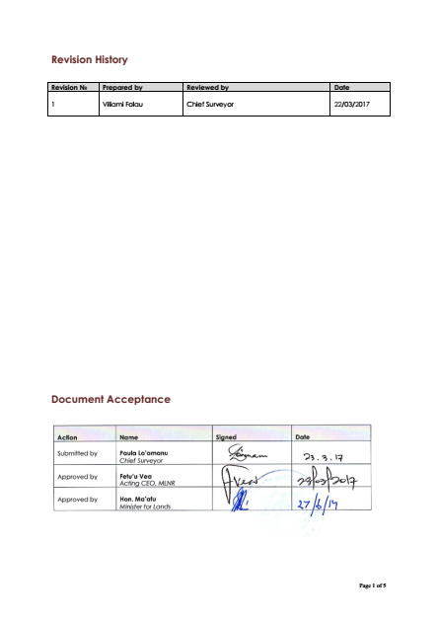
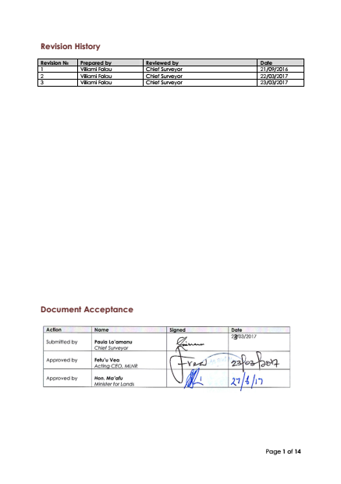
The Surveyors Capacity Building Plan
1. Surveyors Succession Plan
2. Surveyors Training Plan

Slide 4
Why a Capacity Building Plan?
1. Surveyors’ Succession Plan
Issues
Senior Surveyors in management position were approaching retirement
Ministry was not ready for this
Huge gab between these soon to be retired surveyors and potential replacements
Replacements were not ready
Objectives of the Plan
To ensure that there will be no gabs left when experienced surveyors retires
To reduce the risks associated with a loss of experienced leadership.
To create a clear career path and promote continuity.

Slide 5
Succession Plan Process

Slide 6
The Succession Plan

Slide 7
The Capacity Building Plan?
1. Surveyors’ Training Plan
ISSUES
All soon to-be retire senior surveyors have surveying qualification
When they retire, only very few have qualifications
Young surveyors need to have a surveying qualification to ensure sustainability & effective long-term operation
OBJECTIVES OF THE PLAN
To guarantee all surveyors to have a surveying qualification to promote integrity, capability, modernisation and professionalism.
To ensure that surveyors are well trained and equipped to bridge the gap that will be left as experience senior surveyors are approaching their age.

Slide 8
The Training Plan

Slide 9
How the plans were used
Once the two plans were approved by the Minister of Lands, it was circulated to all government Ministries and Agencies but more importantly to the following:
Public Service Commission
Ministry of Education and Training-Scholarship Unit
New Zealand High Commissioners Office
Australian High Commissioners Office
Ministry of Finance and National Planning

Slide 10
Results
Clear Career path | Clear career path for surveyors, technicians and chainman.
Recruitments | Two New Graduate Surveyors | Tongan Govt
In-House Trainings | Surveying Software Topographic survey GNSS Trimble Business Centre | Funded by Ministry Carryout by Graduate Surveyors Andrick Lal SPC through COSPPac
Work Placement | Geoscience Australia SPC LINZ | COSPPac & Tongan Govt SPC & Tongan Govt NZAid
Technical Seminar & Workshops | PGSC, UNGGIM AP, FIG, UNOOSA/USP. | COSPPac, UNOOSA, FIG YSN, SPC & Tongan Govt
University Qualification | Two Diploma in Surveying Two BSurv Currently Otago Two BSurv Otago 2021 One accepted to RMIT BSC Applied Science-Surveying Honours | NZAid & Tongan Govt NZAid & Tongan Govt Both NZAid Hopefully through Australian Awards

Slide 11
Lesson Learned so far….
Three years gone…need to review the plan and improve
Certain aspects needs to be incorporated
Core competencies for surveying and geodesy
Need strengthen monitoring and evaluation
Needs Capacity building plan to ensure fit-for-purpose

Slide 13
THANK YOU
Viliami Folau
Geodetic Survey
Surveying Division

