Slide 1
Fiji Geodetic Infrastructure and Campaign
PGSC Meeting
August 2020

Slide 2
Presentation Outline
Introduction
Purpose
CORS Hierarchy
CORS Network Design
Typical CORS Setup
Reconnaissance and Site Selection
Construction and Installation
CORS Established

Slide 3
Presentation Outline Cont.
ZNetStream Software
Connection to the Local Datum
Field Survey Campaign
Network Adjustment
Fiji Geodetic Datum (FGD) 2020 Launching
Administration
On-going Maintenance

Slide 4
Introduction
United Nations General Assembly 2015
  Resolution 69/266 – “A global geodetic reference frame for sustainable development”; was adopted in its 80th plenary meeting held 26th February 2015
Cabinet Paper - CP(15) 169 29th August 2015
Cabinet Decision 207 – Modernising Fiji’s Geodetic Datum; 29th August 2015

Slide 5
Purpose
The purpose of the project is to provide a precise Geodetic Infrastructure, based on the International Terrestrial Reference Frame (ITRF) that would cover the whole of Fiji
From a geodetic perspective; CORS form an integral component of the nation’s survey and geospatial infrastructure
Modernise Fiji’s obsolete Geodetic Datum into this ITRF

Slide 6
CORS HIERARCHY
Tier 1 CORS – require high stability monuments to support Geoscientific research and global reference frame definition
Tier 2 CORS – require high stability monuments, usually established by the national geodetic agency
Tier 3 CORS – require stable monuments and are established by national geodetic agency, private entity, commercial agencies etc. for the purpose of the densification of the national CORS network. Often supporting real-time positioning applications

Slide 7
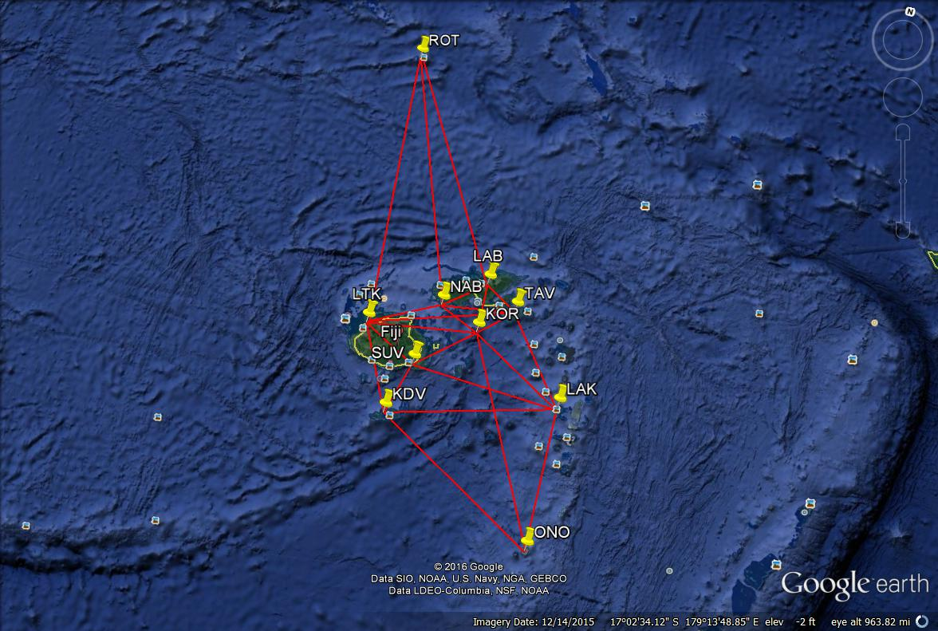
CORS Network Design
Parameters in the design
Distance between the CORS
Connection to reference frame or National Geodetic Datum
Effect of a station outage on service delivery
Typical CORS Network
Tier 1 CORS: 500 to 1500 kilometres
Tier 2 CORS: 80 to 500 kilometres
Tier 3 CORS: 20 to 80 kilometres

Slide 8
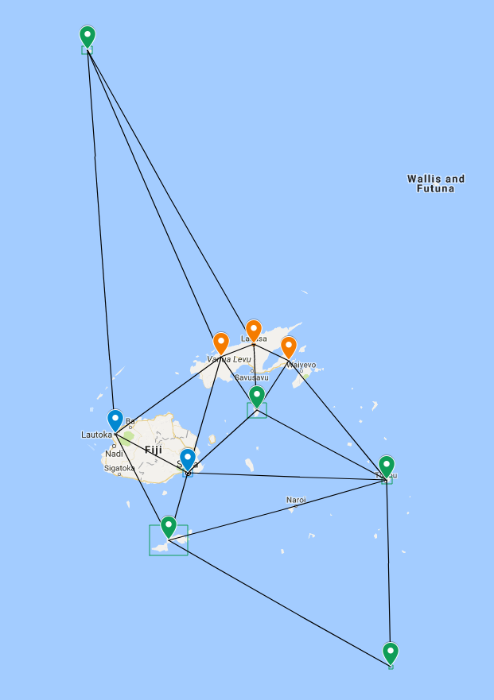
FIJI CORS NETWROK
    LAUTOKA
    SUVA
  High Target Brand
    LABASA
    TAVEUNI
    NABOUWALU
  Leica Geosystems Brand
    ROTUMA
    KORO
    KADAVU
    LAUTOKA
    ONO

Slide 9
Communication Setup
Outdoor
NB: lightening rod has not
been installed
Antenna
MET Sensor
lightning rod
Indoor
Lightning arrester
Router/ Firewall
Lightning arrester
Platoon insert
Fiber modem
Crate
Optical
UPS Power Supply

Slide 10
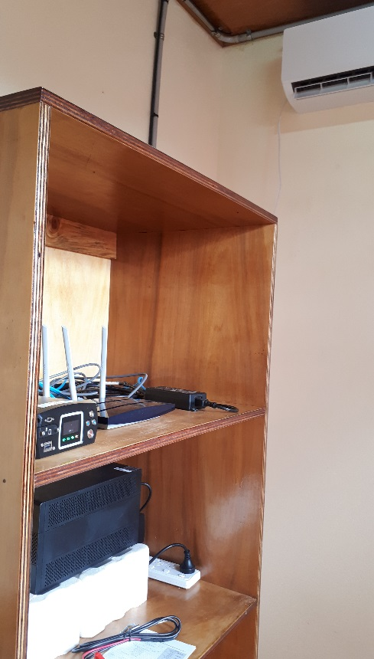
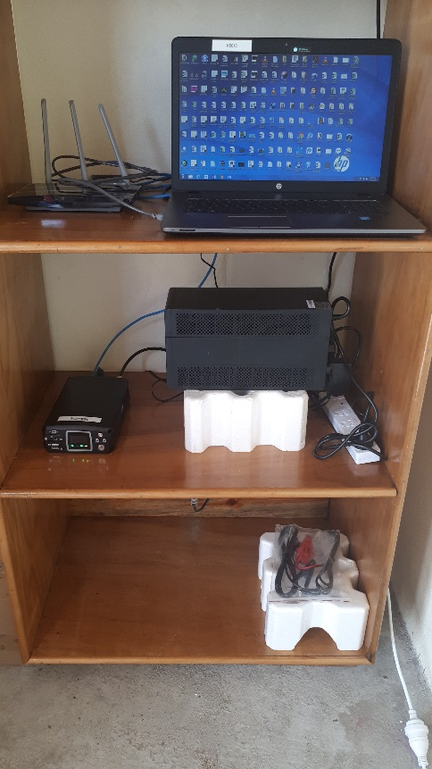
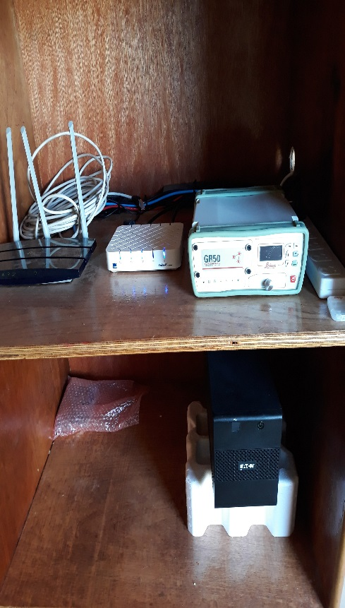
INSIDE THE HUT
Air-Conditioning Unit
Router and Vodafone Internet
Receiver and UPS

Slide 11
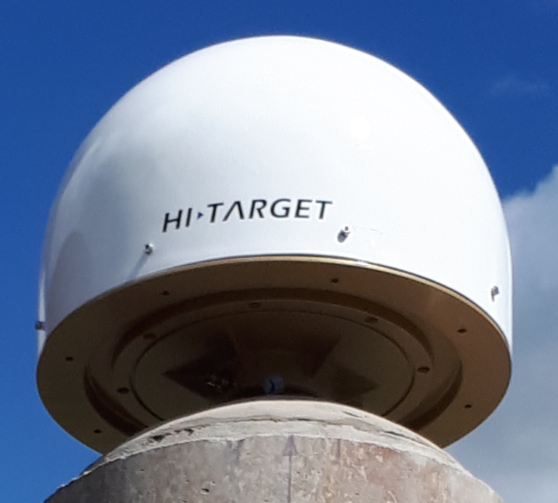

HARDWARE
RECEIVER
ANTENNA

Slide 12

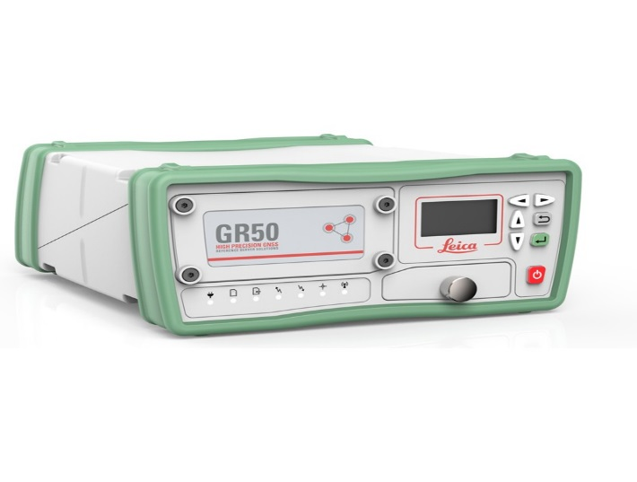
HARDWARE
RECEIVER
ANTENNA

Slide 13
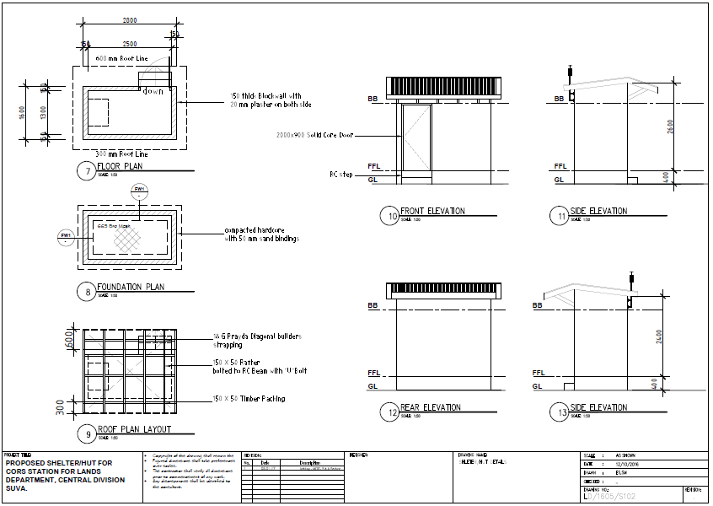
Structural Plan

Slide 14
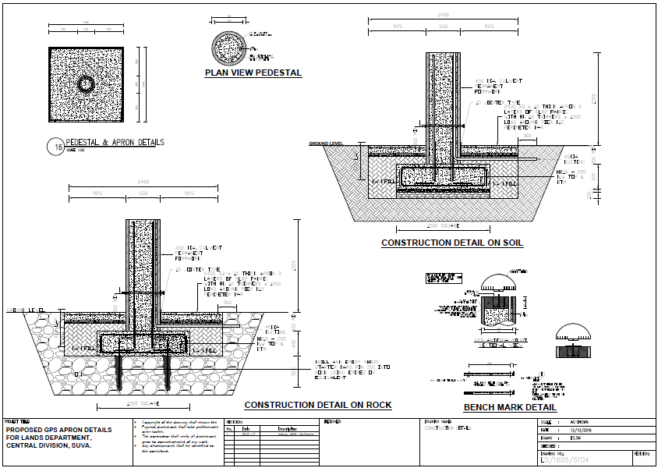

Slide 15
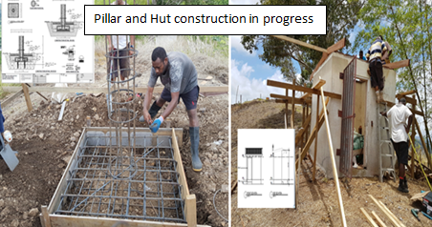
Construction Phase
Labasa Station

Slide 16
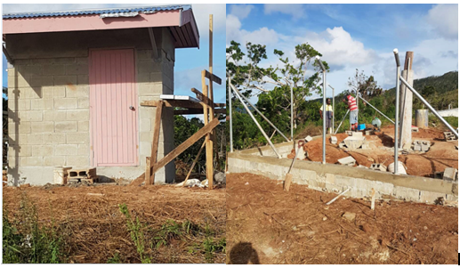
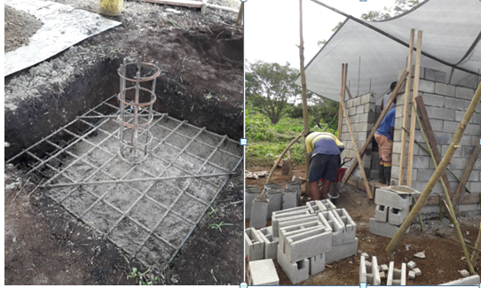
Kadavu
Koro

Slide 17
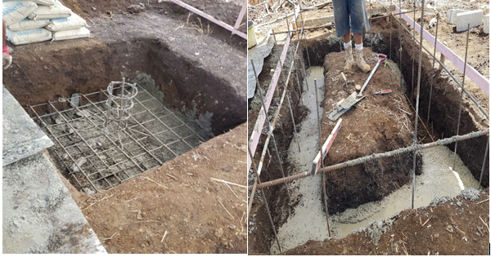
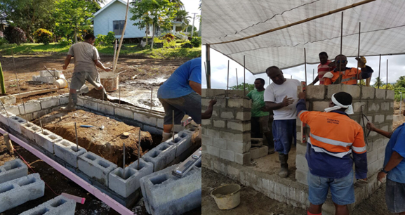
Taveuni Station

Slide 18
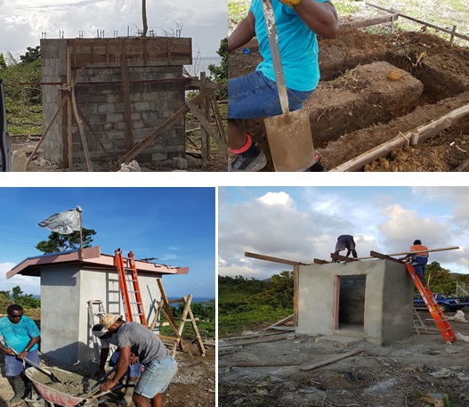
Nabouwalu Station

Slide 19
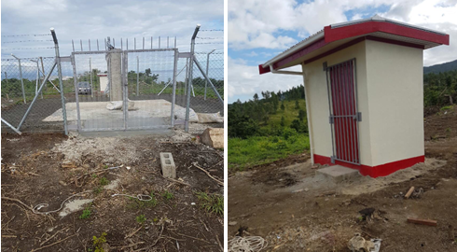
Electricity connection
Air-con unit installed
Mounting of CORS equipment
Solar panels

Slide 20
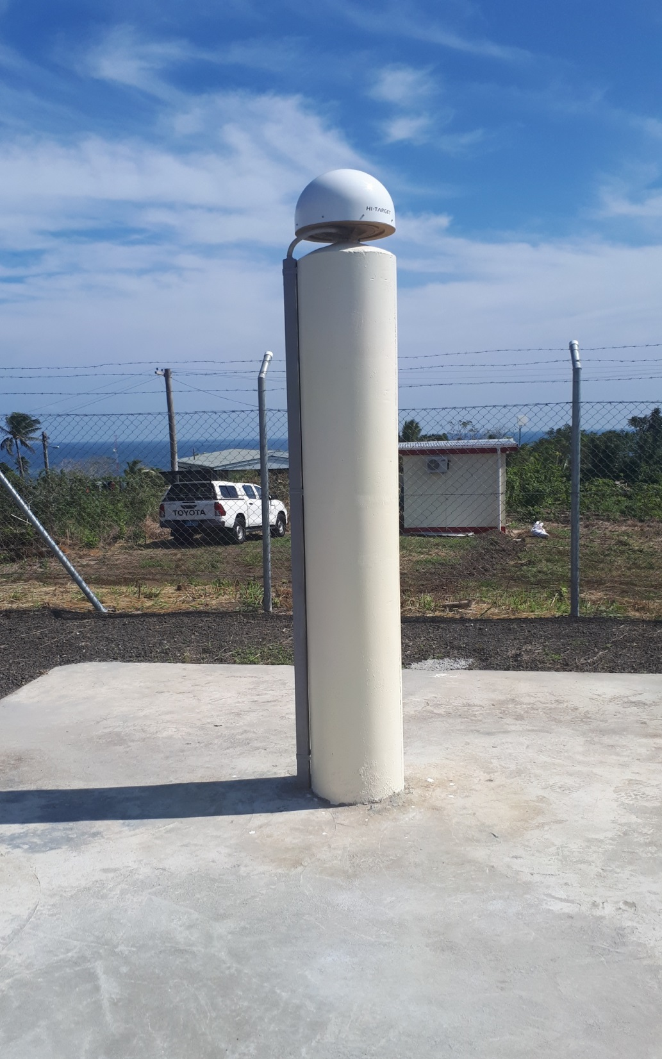

Notes:
A Continuous Operating Reference Station (CORS) comprises of the following:
A GPS receiver
Antenna setup in a stable manner
A safe location
Reliable power supply
Security of land tenure

Slide 21
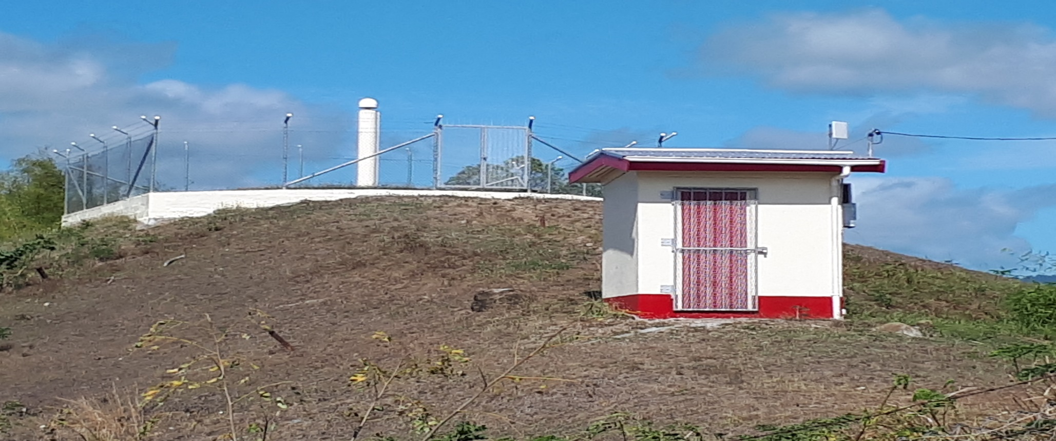
LABASA CORS
PILLAR
HUT

Slide 22
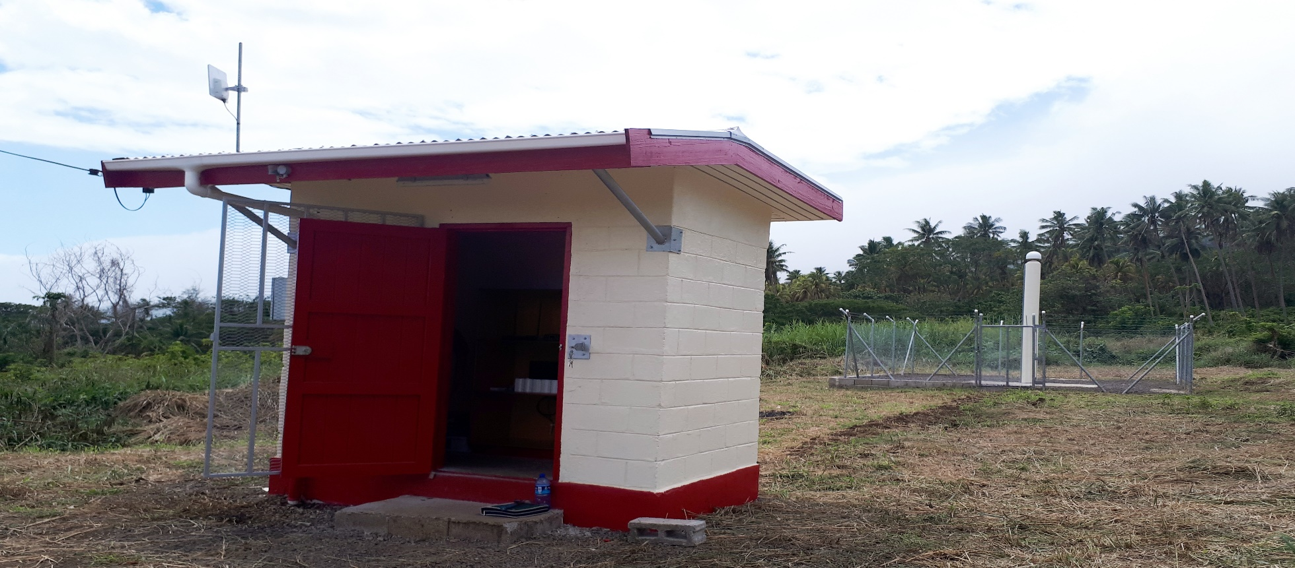
TAVEUNI CORS

Slide 23
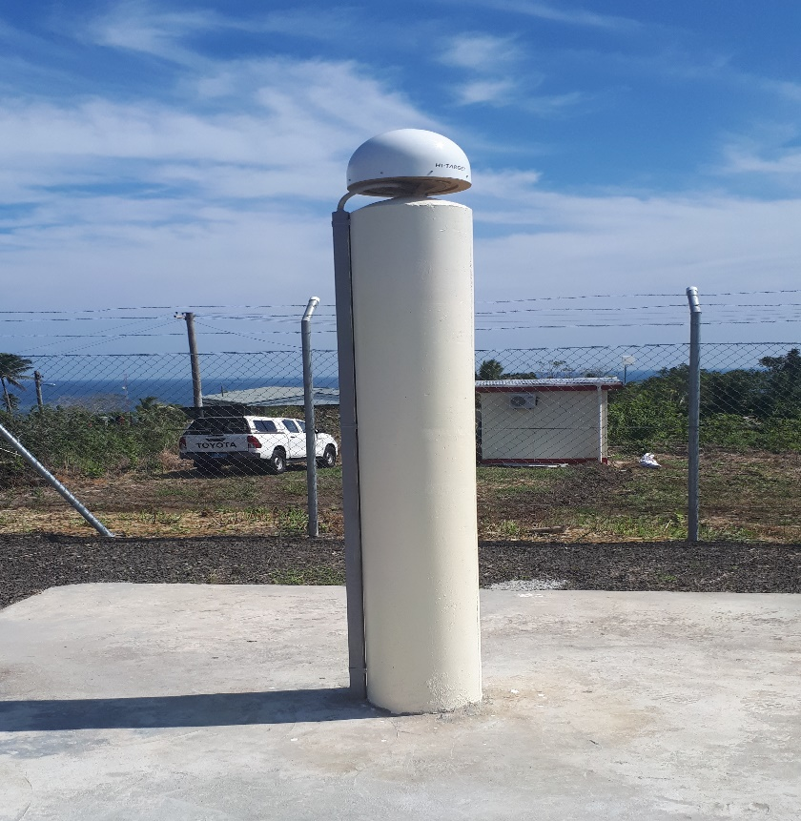
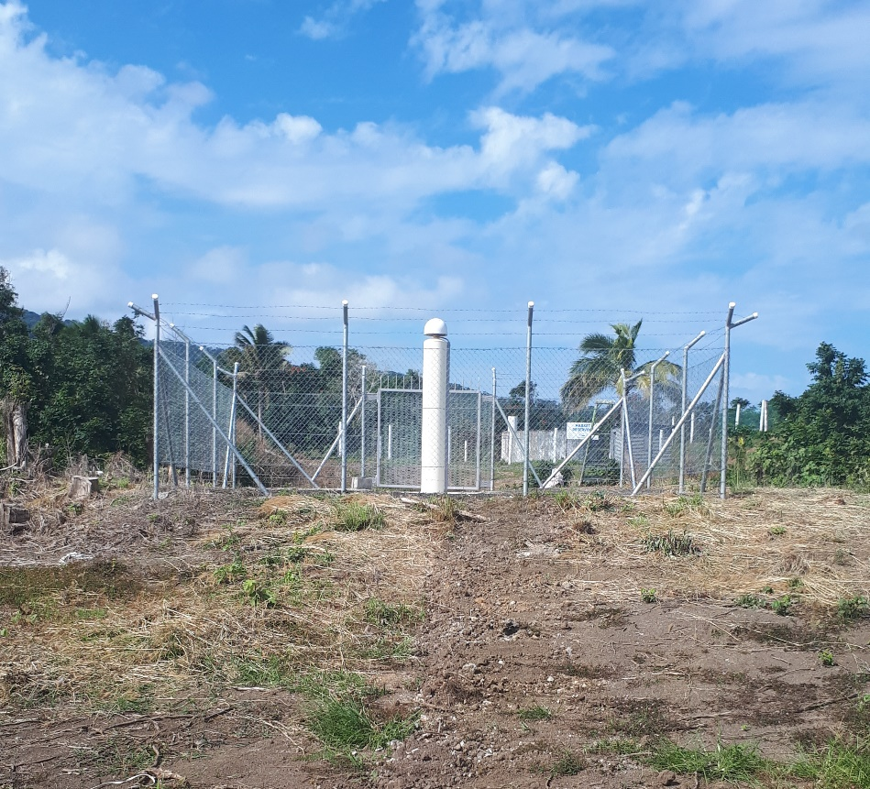
NABOUWALU CORS

Slide 24
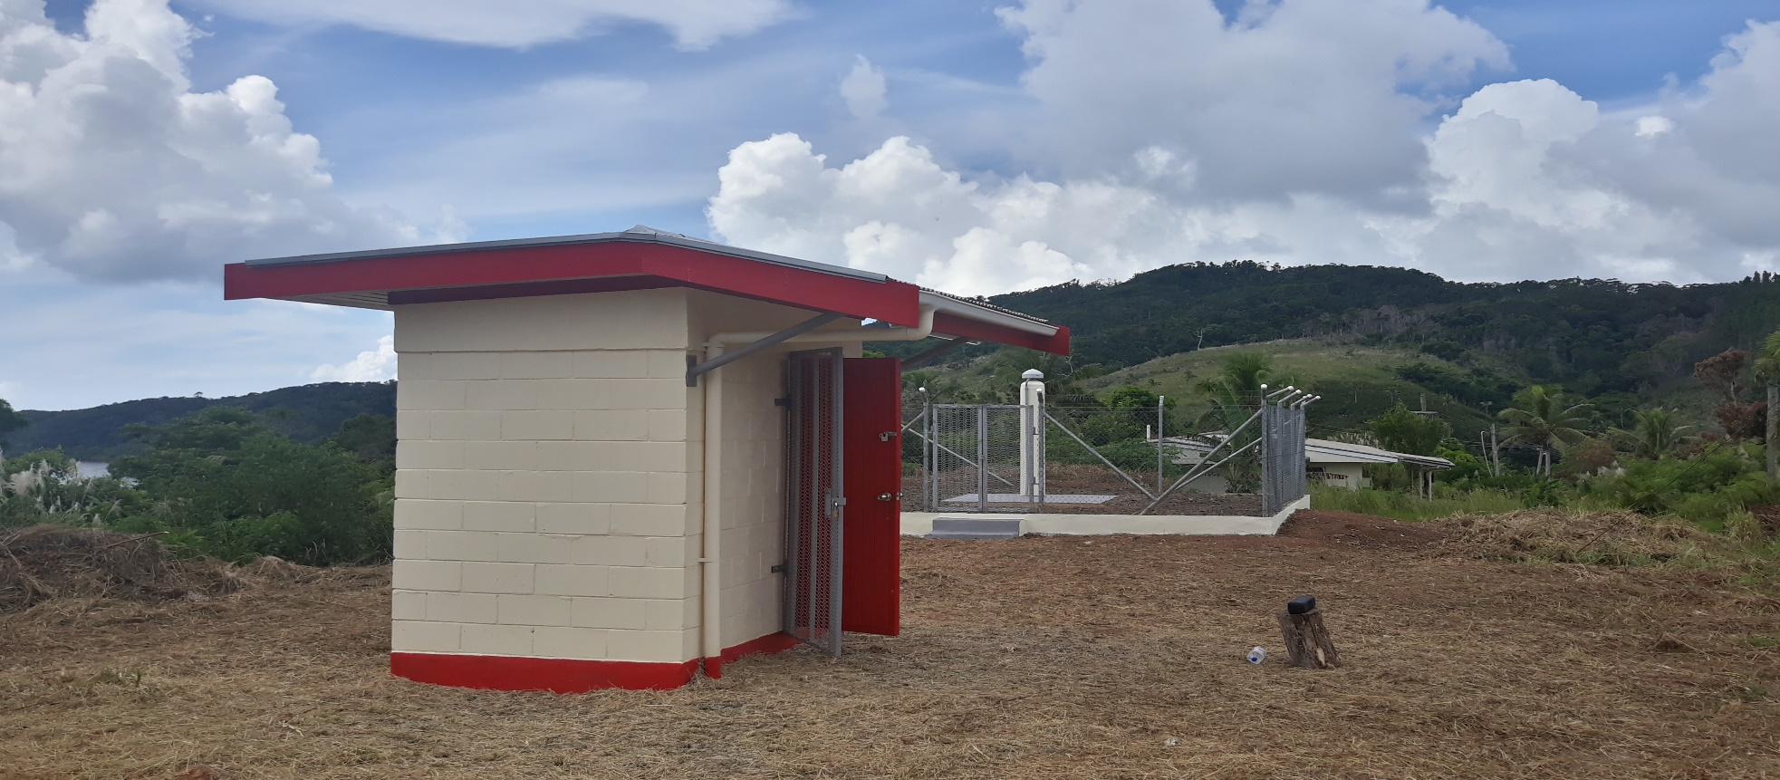
KADAVU CORS

Slide 25
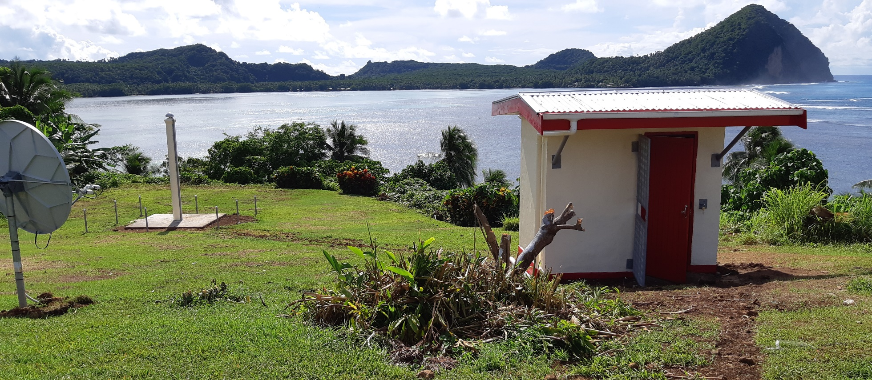
ROTUMA CORS

Slide 26
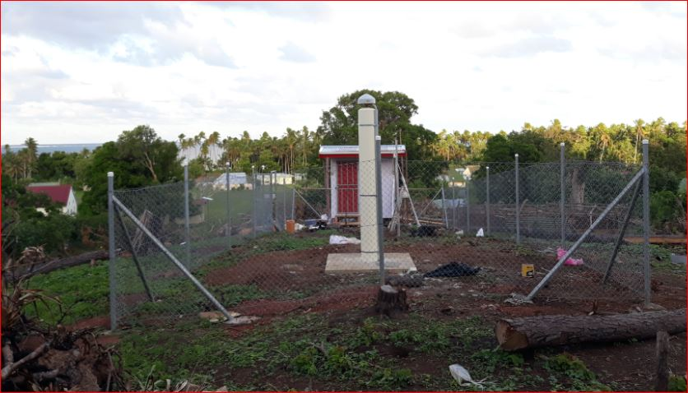
ONO-I-LAU CORS

Slide 27
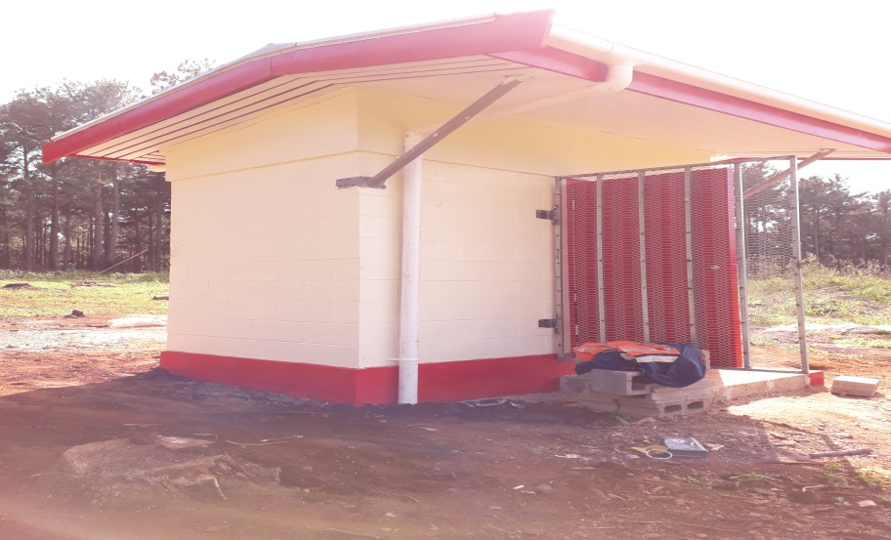
LAKEBA CORS

Slide 28
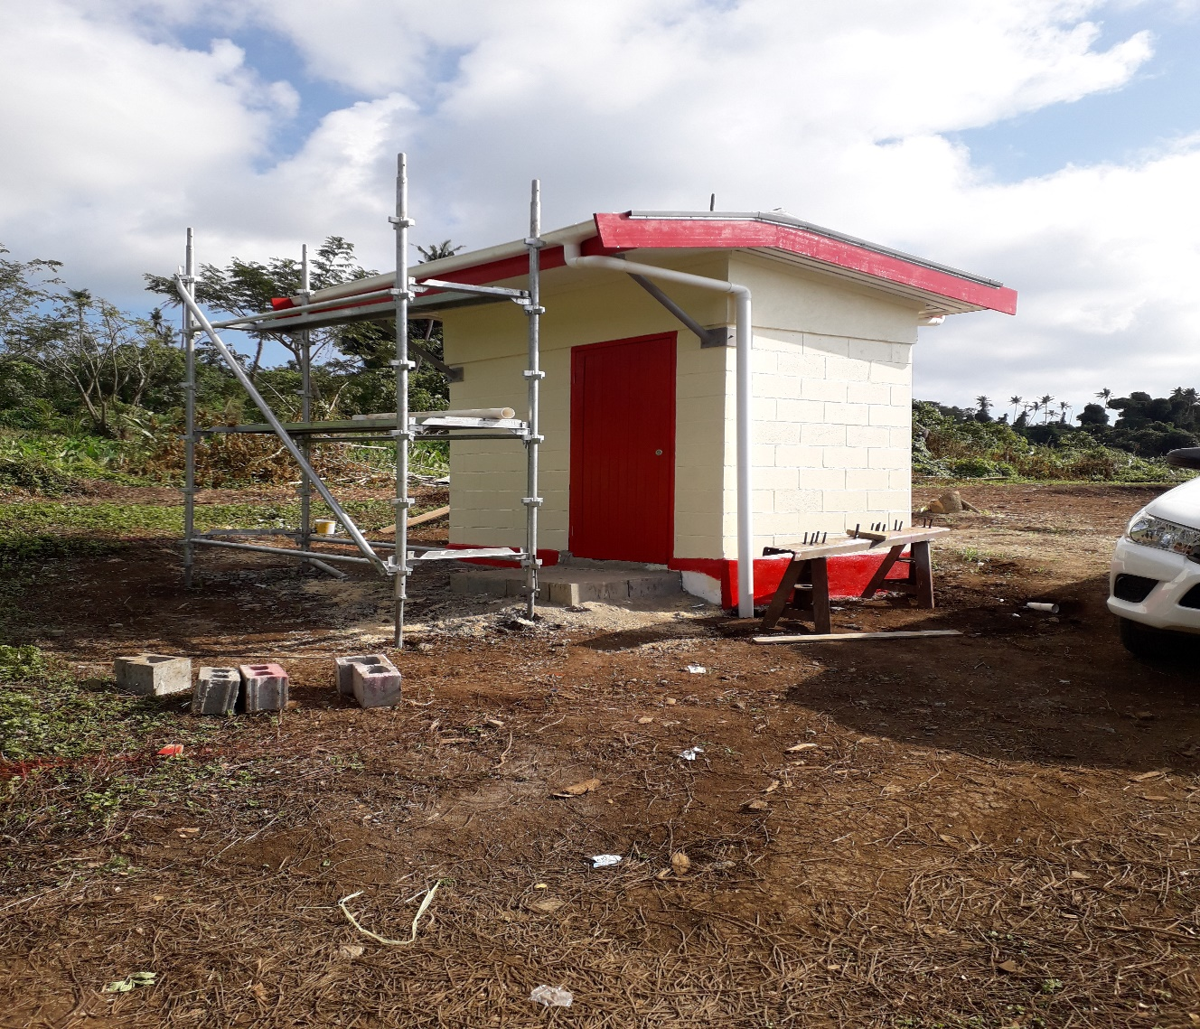
KORO CORS

Slide 29
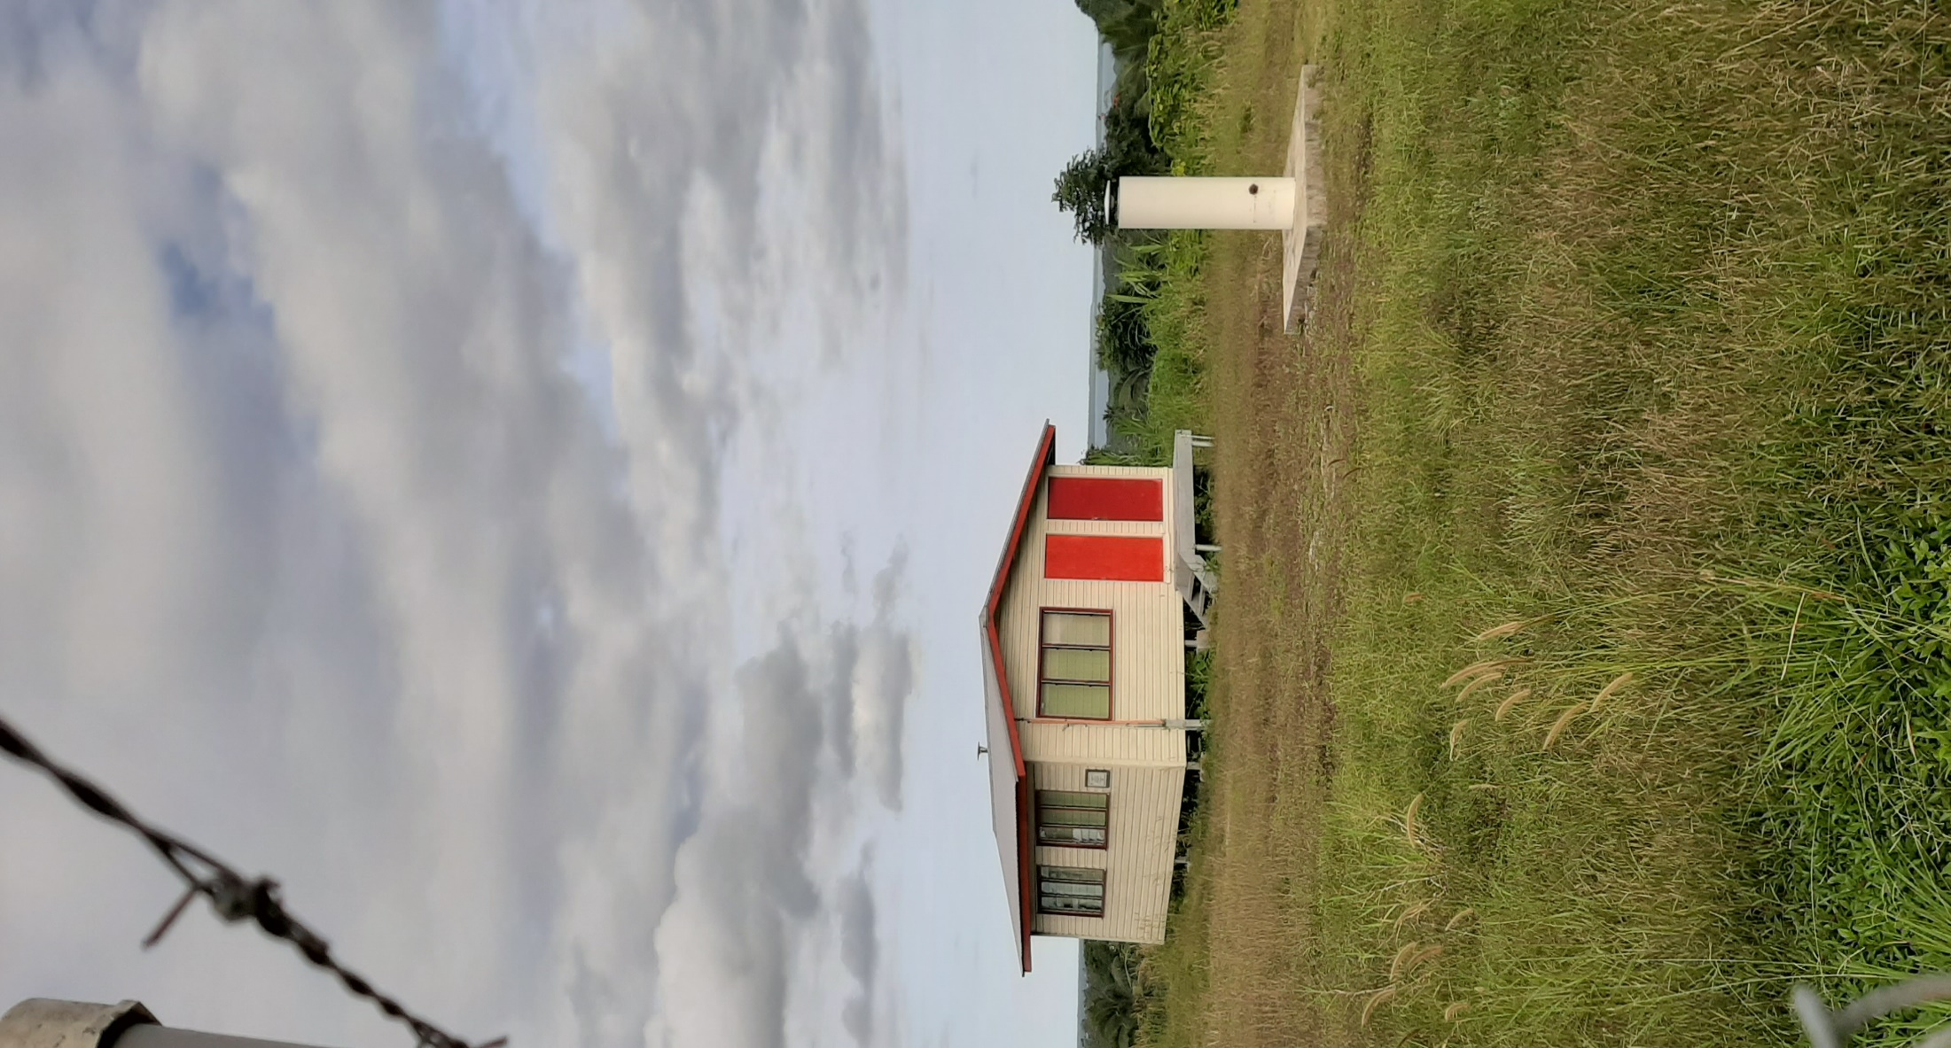
SUVA CORS

Slide 30
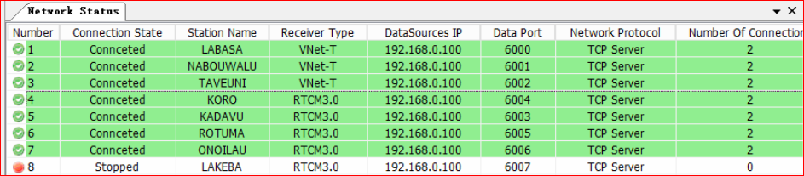
SOFTWARE
ZNetStream
-> Data Streaming and Data Splitting

Slide 31
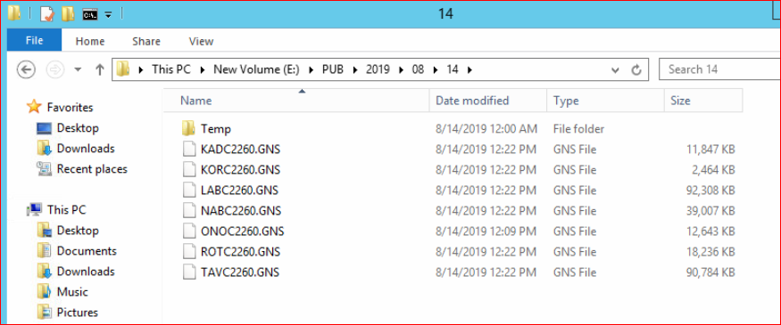
DATA
-> Raw satellite data is
downloaded to the Server in
Suva from the 7 base stations

Slide 32
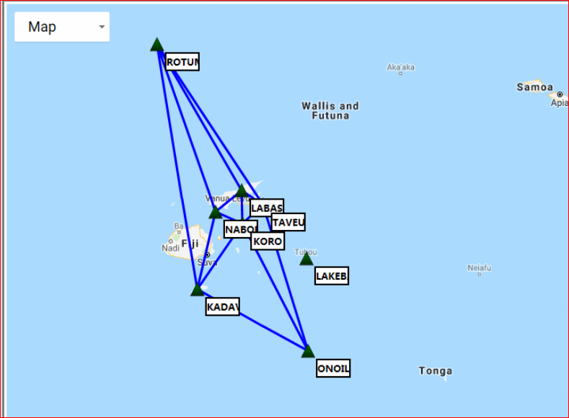
ZNetVRS
-> Multi-base system for Baseline
solving & error modeling.
Also providing Ntrip Service.

Slide 33
DISTANCE BETWEEN EACH CORS
Stations | Distance
LABC - TAVC | 74km
LABC - NABC | 98km
NABC - TAVC | 141km
TAVC -LAKC | 204km
TAVC - KORC | 82km
KORC - LAKC | 214km
LAKC - ONOC | 269km
KORC - KADC | 234km
KADC - ONOC | 369km
KADC - LAKC | 332km
KADC - NABC | 234km
KADC - ROTC | 734km
ROTC - NABC | 528km
ROTC - LABC | 504km
ROTC - TAVC | 572km
KORC - LABC | 96km
KORC - NABC | 86km

Slide 34
Connection - Local Datum
First and Second Order Stations in:
- Viti Levu
- Vanua Levu
- Maritime Islands
- EEZ Boundary Delimitation Network
- Standard Survey marks

Slide 35
Field Survey Campaign Network

Slide 36
Field Survey Campaign Work Plan
Survey Specifications
Survey Implementation Plans
Logistics – Ships, Equipment, Stores
Field Operators Manual

Slide 37
Field Survey Campaign - Phase 1
Personnel
Total Staff- 58
Fiji Navy 25,
Land Department – 28
SPC 5
Transportation
3 Royal Fiji Navy Ships
- Kula, Kikau, Kacau: Southern Fiji, Ceva-i-ra
Local Ferry
MV Lomaiviti Princess – (Kadavu and Gau)
Vehicles - 2

Slide 38
Phase 1 – Equipments and Stations Occupied
GNSS Receivers
- Leica - 16
- Trimble - 7
Stations Occupied
- 12 Primary Stations – 7 day observations
- 42 Secondary Stations – 6 hour observations

Slide 39
Field Survey Campaign - Phase 1
Personnel - 60
- Fiji Navy 25
- Control 33,
- SPC 2
Transportation
Vessels
1 Royal Fiji Navy Ship – Kacau
- Vatulele, Mamanuca, Yasawa Islands
Local Ferry - Ovalau Island, Vatu-i-ra
Vehicles – 6

Slide 40
Phase 2 – Equipments and Stations Occupied
GNSS Receivers
- Leica - 16
- Trimble - 7
Stations Occupied
- 22 Primary Stations – 7 day observations
- 23 Secondary Stations – 6 hour observations

Slide 41
Field Survey Campaign - Phase 3
Personnel - 63
- Fiji Navy - 20
- Lands Department – 41
- SPC - 2
Transportation
Vessels
1 Royal Fiji Navy Ship – Kacau
- Udu Pt, Qelelevu, Cikobia
Local Ferry - Taveuni, Qamea, Rabi, Kia, Rotuma
Vehicles – 5

Slide 42
Phase 3 – Equipments and Stations Occupied
GNSS Receivers
- Leica - 14
- Trimble - 5
Stations Occupied
- 18 Primary Stations – 7 day observations
- 23 Secondary Stations – 6 hour observations

Slide 43
Solar and Battery Power
Solar Installed
Ono-i-lau
Lakeba
Battery Power Backup
Rotuma
Nabouwalu
Labasa

Slide 44
Network Adjustment
Geodetic Adjustments at GA
FGD 2020 and Launching
Conversion of Existing Survey Plans - 41,178
Establishment of Tide Gauges
Precise Levelling to all CORS
Extend the CORS network

Slide 45
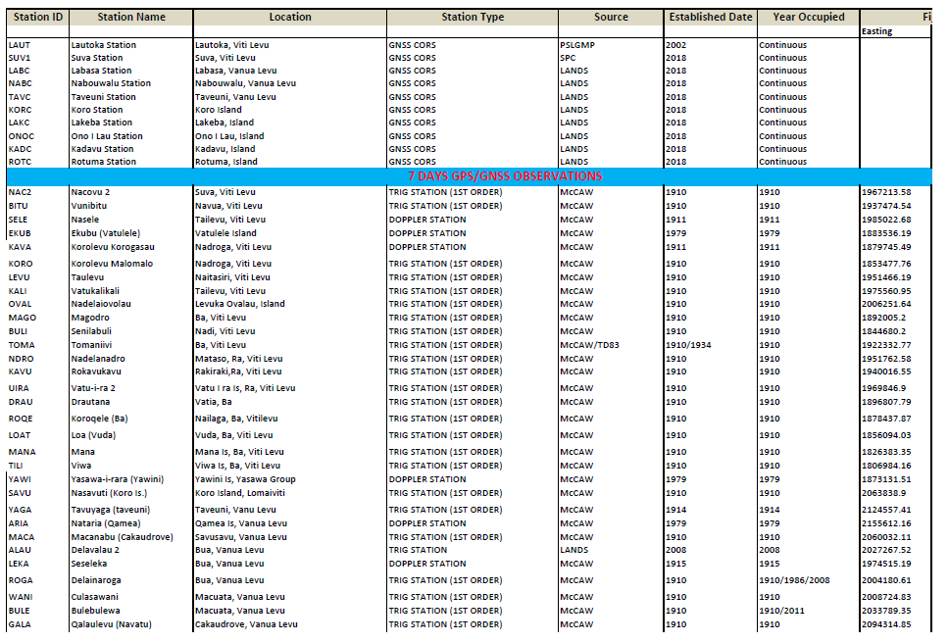
Data Synchronisation

Slide 46
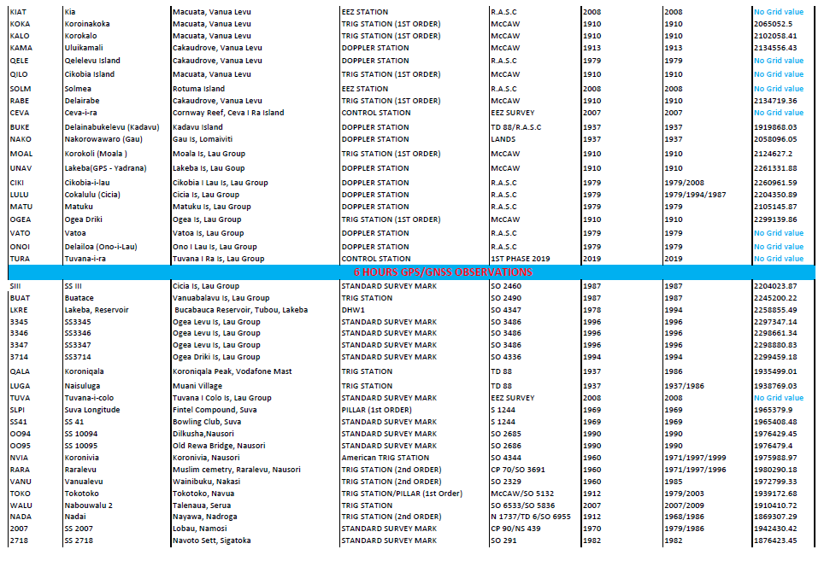

Slide 47
Administration
Geodetic Survey Office/Agency Established
Procurement of relevant software
Training on the software
Capacity Building
Geodetic Survey 10 Year Strategic Plan
Formulate Policies
Licensed End Users
GNSS GPS Data Management

Slide 48

Capacity Development Need
Local Datum
Series of Activity
Modern Datum
Understanding of GNSS
GNSS CORS Network Management
Reference Frame (Horizontal and Vertical Datum)
GNSS Processing, Computation and Adjustment

Slide 49
Capacity Development Need
Modern Datum
Series of Activity
Accessibility to
Modern Datum
Development of Policy and legal framework
Understanding HOW modern datum contribute to country’s economy
How modern datum address emerging issues (Climate Change & Sea Level Rise)
Sustainability of the datum (Experience and qualified Personnel)
Transforming of existing geospatial information to new datum
Formulate new Policy and Guideline
Managing Geodetic Infrastructure

Slide 50
Challenges
Issue / Challenge | Specific Problem | Strategy to Mitigate
Data Sharing Data charging versus “open” / “free” data policy Data infrastructure vs data service delivery | Sharing of data limited resulting in non-optimum outcomes National legislation /regulation / policy hinders sharing | Preparation of an pro-forma data agreement to assist with setting up agreements Establishing a forum for discussion, exchange of ideas Encourage participation in common regional / sub regional cause Focus the need on broader objectives / perspectives so as to articulate the importance of data sharing Political “will” is an important factor and needs to be addressed and obtained Examine the “parameters” / caveats surrounding data sharing and then discuss Refer to international standards as a means e.g RINEX / SINEX

Slide 51
Technical capability | Lack of technical expertise is impeding geodetic infrastructure | Consider using or creating a data centre in the region More workshops on implementation Opportunities to be trained at agencies that have the experience (noting - funding is an issue) Engage better with academic institutions Develop a regional training framework based on “standards”, specifications, guidelines Explore opportunities with private sector to provide training (noting funding is an issue) Raising awareness of geospatial in primary / secondary educational curriculum Develop a mechanism for short term attachments, internships on specific projects / disciplines (noting funding is an issue) Use the network of professional surveyors Use the national requirements for CPD to develop knowledge on geodesy / geospatial

Slide 52
Ongoing Maintenance
Maintenance of CORS Infrastructure
CORS IT Infrastructure maintained
Capacity Building
GNSS GPS Data Management
Upgrade relevant software – SmartNet????
Replacement of GNSS CORS equipment

Slide 53
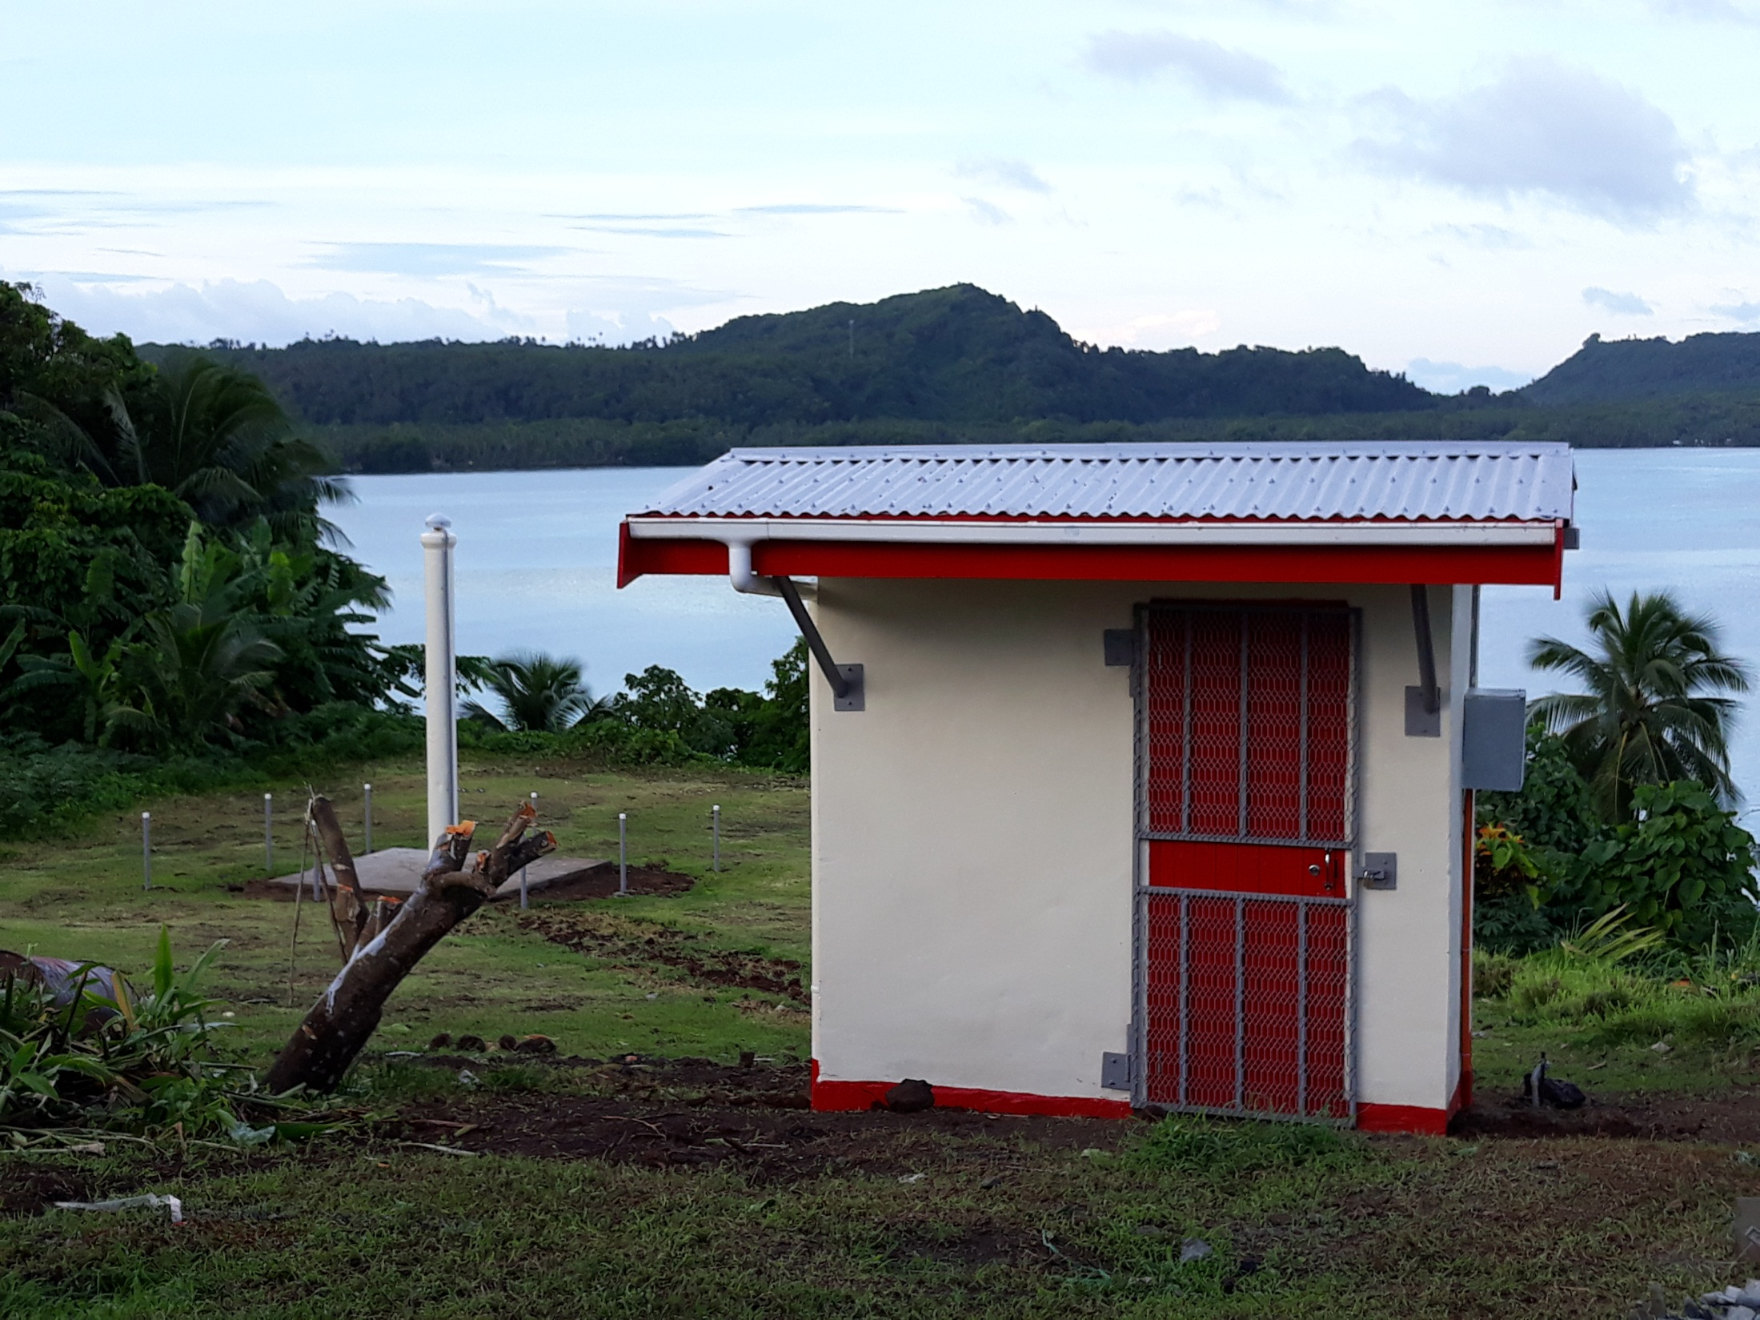
Vinaka
THANK YOU

