Slide 1
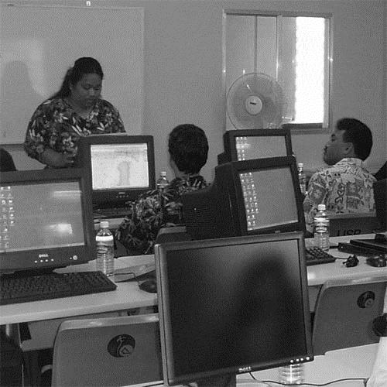
PGSC WORKING GROUP progress
Geospatial Policy & Data Management
5th Pacific Geospatial and Surveying Council Meeting
11th August 2020

Slide 2
PGSC Working group mandate
This Working Group primarily supports Goal 2 of the PGSC Strategy:
This Working Group falls under Goal 2 of the Strategy, focused on the development of Technology & Standards.
All working groups are also tasked to seek out resources to support sustainable PGSC activities, as per Goal 3.
Formed in Sydney (November 2019) at the 19th Regional Maritime Boundaries Workshop in the interest of Geospatial & Data Management Policy

Slide 3
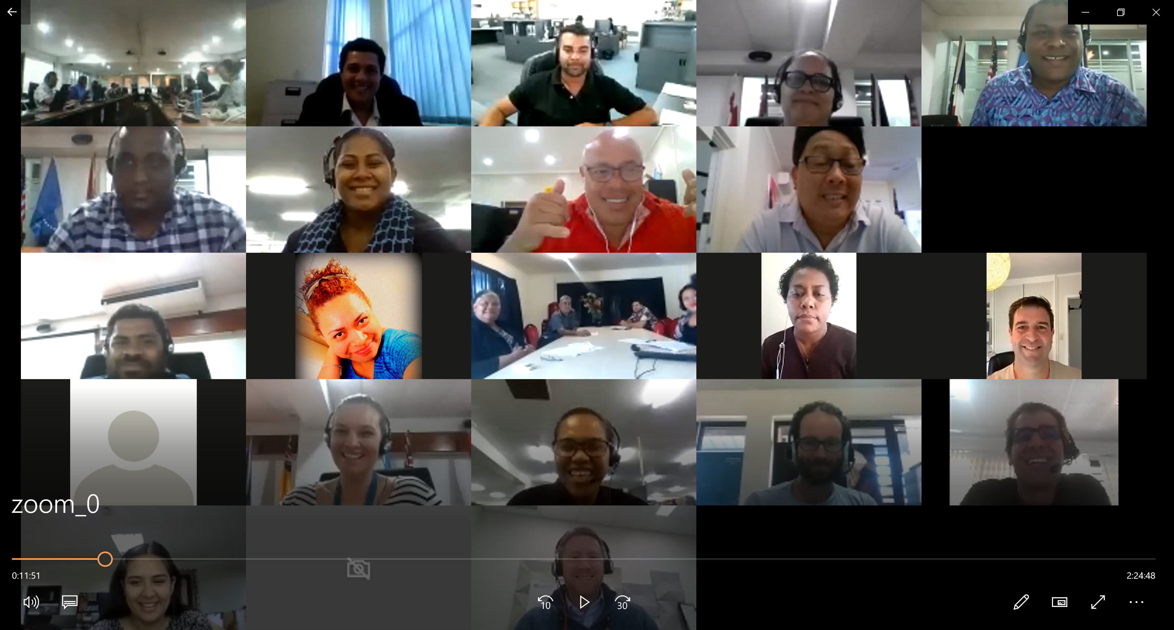
PGSC Working Group Virtual (Zoom) Meeting
Date: 30 July 2020 (11am to 1pm - Fiji Time)
Participants: Twenty Seven (27)
Countries: Tuvalu, Cook Islands, Fiji, Tonga, Kiribati
Agencies: SPC, GA, IIC, FIG-APCDN, UN-GGIM
Chair: Ms. Meizyanne Hicks, Fiji
Host: Mr. Malakai Vakautawale
Scribe: Ms. Merana Kitione
Rapporteur: Mr. Frank Vukikomoala

Slide 4
PGSC Working Group Activities
Activities | 2018-2020 Progress
Identify the current status of existing or draft PIC geospatial policies. | Cook Islands; National Geospatial policy endorsed by government in April 2020 Shared with the PGSC Partnership Desk for member states. Palau; has a national policy on geospatial data collection. Tuvalu; no policy on geospatial. Currently working on a surveying legislation. Fiji; geospatial policy (work in progress) Tonga; progressing with National Action Plan for Geospatial Information Community consultation on marine spatial planning. IUCN. Kiribati; no national policy on geospatial.

Slide 5
PGSC Working Group Activities
Activities | 2018-2020 Progress
Engage regional and international agencies for assistance and capacity building | UNGGIM Workshop on Legal and Policy Framework for Geospatial Information (2018) UNGGIM supporting implementation of IGIF at the country level (National Action Plans). Regional workshop had been planned for April 2020- hope to be able to do this next year. Standing ready to share with the council and this meeting the approach and resource materials developed. Regional Committees – IGIF. Support to countries. Country-owned, country-led. Support with resources (approach) - Fiji/Tonga examples. Capacity development, institutional development. PGSC – presentation; committee of experts, implementation of IGIF in the region. marine and geospatial management. Process for representation of PIC in UNGGIM Working Groups. Young professionals, capacity building opportunity. Membership by TOR, open to all member states. Expression of interest to be part of WG. Young professionals – activities – open to nominations from member states. Open events. Virtual forums – high attendance. GA, FIG, SPC support Pacific GIS & RS User Conference (yearly event) Pacific GIS & Remote Sensing Council (PGRSC) GIS Pacnet (regional GIS/RS mailing list) PGSC paper to UNGGIM

Slide 6
PGSC Working Group Activities
Activities | 2018-2020 Progress
Development of protocol at national level to consult local stakeholders, develop and socialise strategy | Cook Islands; Policy developed for the purpose of sharing data (government and private sector) Fiji; National GIS & RS user group meets monthly Tonga; National Action Plan for Geospatial Information stakeholder workshop Kiribati- marine spatial planning survey, 8-9 more atolls to survey, engaging stakeholders.
PGSC to develop regional statement encouraging all members to align with IGIF | Endorsement from Fiji, Tuvalu, Cook Islands, Tonga and Kiribati.
PGSC and Partnership Desk to support countries in steps of the process | Encourage and facilitate (sharing of lessons learnt, documents, draft policies, engagement/consultation approaches) Support activities with technical assistance, equipment, personnel

Slide 7
Challenges faced
Policy development – technical background and guidance
Support from government agencies.
Lack of public/stakeholder on understanding of technical jargon
Availability of technical assistance from SPC, UNGGIM and others and other agencies to develop geospatial policies.
Needs for data sharing policy.
National protocol and data control.

Slide 8
Opportunities
UN-GGIM; Regional committees and IGIF
Regional statement/ resolutions.
PGSC present paper to UNGGIM 10th Session (August 2020)
FIG assistance
UNESCO to support activities
New Caledonia to join PGSC and very interested in geospatial policy

Slide 9
THANK YOU Vinaka

